Slide 1
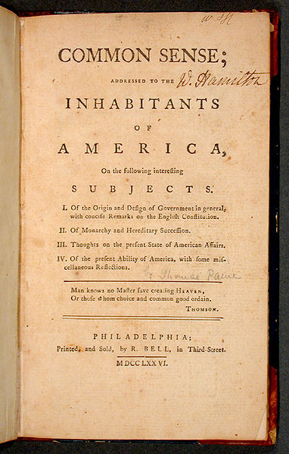
APUSH Review: Thomas Paine’s Common Sense
www.Apushreview.com
Everything You Need To Know About Thomas Paine’s Common Sense To Succeed In APUSH

Slide 2
The New Curriculum And Common Sense
Key Concept 3.2, I, B: “The colonists’ belief in the superiority of republican self-government based on the natural rights of the people found its clearest American expression in Thomas Paine’s Common Sense and in the Declaration of Independence.”
Page 34 of the Curriculum framework
Common Sense played an intricate role in influencing the colonists’ decision to declare independence
Since it is mentioned specifically, you should be very familiar with it

Slide 3
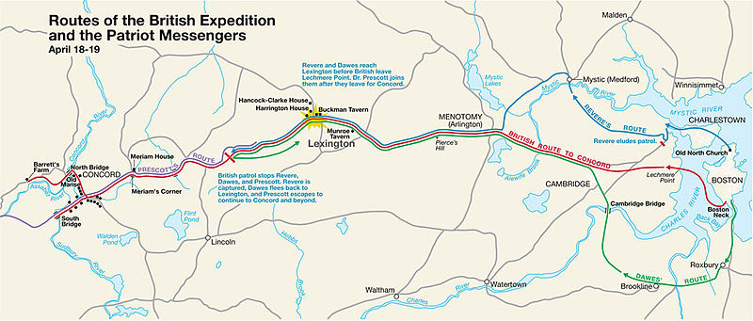
Events Prior to Common Sense (January 1776)
1775:
April – Battles of Lexington and Concord
July – Olive Branch Petition – colonists hoped to have peace and grievances addressed, rejected by KG3
Throughout 1775 and the early part of 1776, most colonists did NOT want independence
Rather, they were seeking a redress of grievances and to go back to the days of salutary neglect

Slide 4
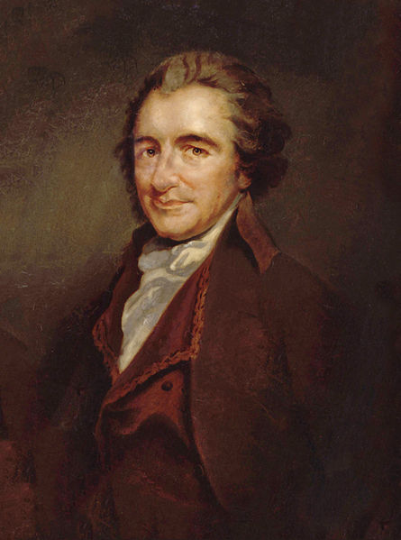
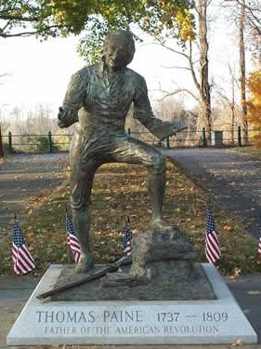
Enter T-Paine
Who was he?
Philosopher from England that moved to America in 1774
Ideas reflected the Enlightenment
Why did he publish Common Sense?
He urged America to break away from Britain and KG3

Slide 5
The Message and Impact
You get a Common Sense!
You get a Common Sense!
You get a Common Sense!
You get a Common Sense!
You get a Common Sense!
The book was divided into 4 sections
Origins of government and remarks on English Constitution
Monarchy and Hereditary Succession
Present state of American affairs
Present ability of America
It was written to appeal to common people
Proportionally to the population at the time, it is the best-selling book in American history
As many as 500,000 copies to a population of 2.5 million
You get a Common Sense!

Slide 6
Test Tips
Multiple-Choice Short Answer Questions:
Perhaps an excerpt from the reading: what was the purpose
Cause of the Revolution
Essay Questions:
Part of the influences (causes) of the American Revolution

Slide 7
Thanks for watching!
Subscribe to my channel
Help spread the word
Questions? Comments?
Leave in comments
You get to subscribe!
Subscribe
Down here!

